Slide 1
Topics
Review of Low-Level vs. High-Level Languages
Algorithms - the Process of Designing a Program
Input, Processing, Output
Python Language Basics
Coding Rules
Comments
Variables and Data Types
Displaying Output
Reading Input
Performing Calculations

Slide 2
Review of Low-Level vs. High-Level Languages
Low-Level Language
A language that machines understand.
Slight abstraction (if any) from machine code.
High-Level Language
A language humans understand.
Python is a High-Level, Interpreted Language
PyCharm is an Integrated Development Environment (IDE) we can write Python code in.
Text Editor
File Organizer/Explorer
Interpreter and Debugger

Slide 3
Algorithms - the Process of Designing a Program
Programs must be designed before they are written
Program development cycle:
Design the program
Write the code
Correct syntax errors
Test the program
Correct logic errors

Slide 4
Designing a Program (cont’d.)
Design is the most important part of the program development cycle
Understand the task that the program is to perform
Work with customer to get a sense what the program is supposed to do
Ask questions about program details
Create one or more software requirements

Slide 5
Designing a Program (cont’d.)
Determine the steps that must be taken to perform the task
Break down required task into a series of steps
Create an algorithm, listing logical steps that must be taken
Algorithm: set of well-defined logical steps that must be taken to perform a task

Slide 6
Designing a Program (cont’d.)
Pseudocode: fake code
Informal language that has no syntax rule
Not meant to be compiled or executed
Used to create model program
No need to worry about syntax errors, can focus on program’s design
Can be translated directly into actual code in any programming language

Slide 7
Algorithm – Boiling Water Problem
Problem: Boil a pot of water.
Algorithm Steps/Tasks:
Get a pot.
Pour desired amount of water in the pot.
Put the pot on a stove burner.
Turn the burner to high.
Watch the water until you see bubbles rapidly rising.

Slide 8
Algorithm – Pay Calculation Problem
Problem: Write a program to calculate and display gross pay for an hourly-paid employee.
Algorithm Steps/Tasks:
Get the number of hours worked.
Get the hourly pay rate.
Multiply the number of hours worked by the hourly pay rate.
Display the result of the calculation performed in step 3.

Slide 9
Algorithm – Pay Calculation Problem
Pseudocode:
Display “Enter the number of hours the employee worked:”
Input hours
Display “Enter the employee’s hourly pay rate:”
Input payRate
Set grossPay = hours * payRate
Display “The employee’s gross pay is $”, grossPay

Slide 10
Input, Processing, Output
Typically, computer programs perform a three-step process
Receive input
Perform some process on the input
Produce output
When programming, always think IPO.

Slide 11
Python Coding Rules
Python relies on proper indentation. Standard indentation is 4 spaces.
Can write one statement on multiple lines using the \ (backslash) character.
Normally, statements will execute in the order they appear from top-to-bottom.

Slide 12
Comments
Comments: notes of explanation within a program
Ignored by Python interpreter
Begin with a # character
End-line (or line) comment – appears at end of a line of code and describes the purpose of that line.
Block comment – appears on its own line and describes a section of code.
Why is commenting important?
Helps in debugging errors – comment one line at a time until your program runs with no errors.
Helps a programmer after you understand difficult portions of code logic and what you were trying to do.

Slide 13
Variables and Data Types
Variable: name that represents a value stored in the computer memory
Assignment statement: used to create a variable and make it reference data
General format is variable = expression
Example: age = 29
Assignment operator: the equal sign (=)
You can only use a variable if a value is assigned to it.

Slide 14
Variables and Data Types
Rules for naming variables in Python:
Variable name cannot be a Python key word
Variable name cannot contain spaces
First character must be a letter or an underscore
After first character may use letters, digits, or underscores
Variable names are case sensitive
Variable name should reflect its use
Good practice to separate words in variable name with underscores or use camel-case.
Examples: miles_per_gallon or milesPerGallon

Slide 15
Variables and Data Types
Data Type: defines the type of data you are using in a variable.
Three Python Data Types:
str – String – character or text data
Examples: “Mike”, “40”, “Please Enter Name:”
int – Integer – set of whole number
Examples: 21, 450, 0, -35
float – Floating Point Number – set of numbers requiring decimal points
Examples: 21.9, 450.25, 0.01, -25.2, 3.1416

Slide 16
Variables and Data Types
Variables can be reassigned to new values during program execution.
Python removes the previous value (called “garbage collection”).
The new value can have a different data type than the previous value.
Representing strings and numbers in code:
String literals – strings that actually appear in code.
Enclose string literals with either double or single quotes.
Numeric literals – numbers that actually appear in code.
Do not enclose numeric literals with quotes.
For numbers, a string literal is different than a numeric literal (example – “5” does not equal 5 – “5” is the “character 5”)

Slide 17
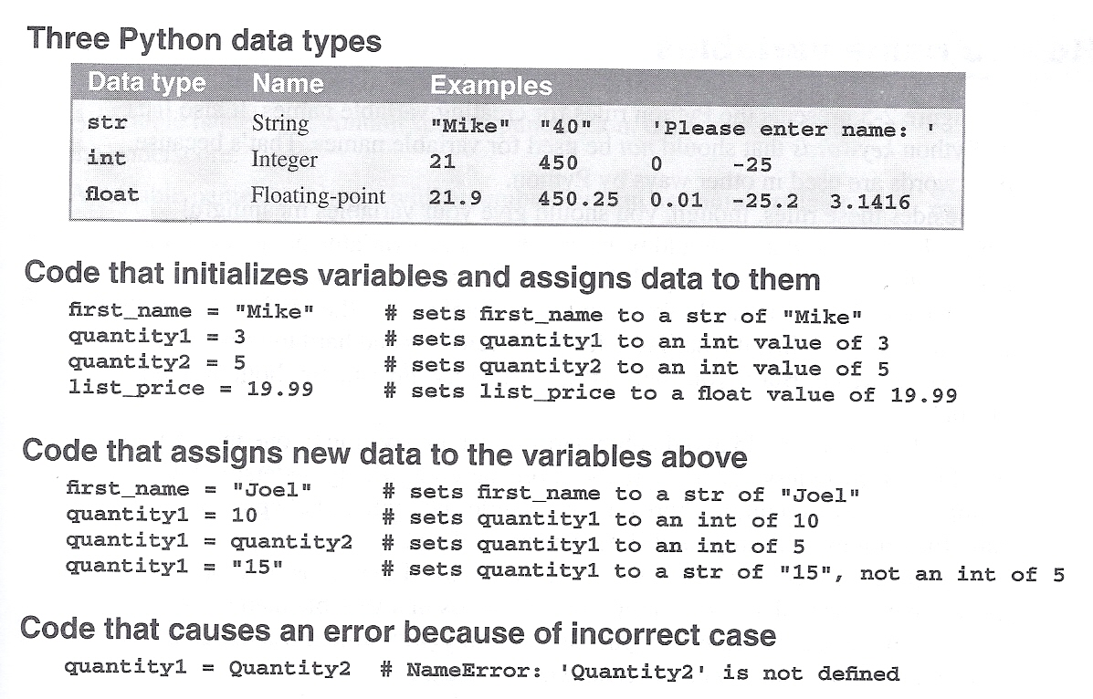

Slide 18
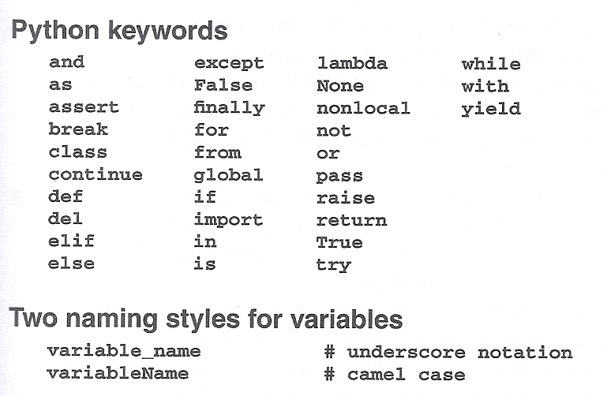

Slide 19
Displaying Output with the print Function
Function: unit of prewritten code that performs a specific operation
Argument: data given to a function
print function: displays output on the screen
Arguments are the data to be printed to the screen.
Python allows multiple arguments for a single print
Arguments are separated by commas
Arguments displayed in the order they are passed to the function
Items are automatically separated by a space when displayed on screen

Slide 20
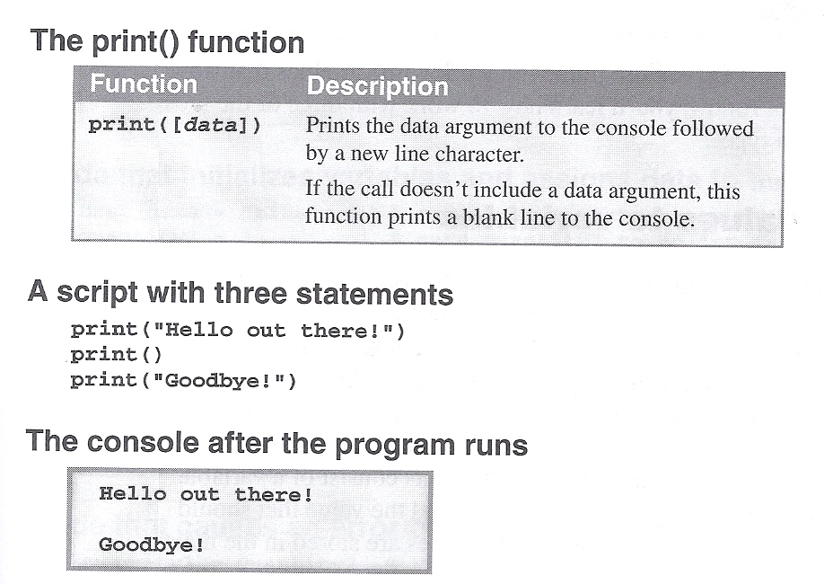
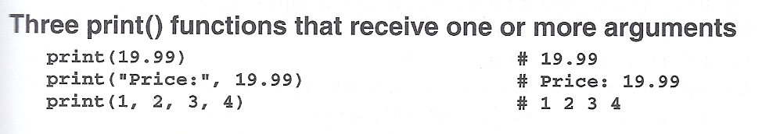

Slide 21
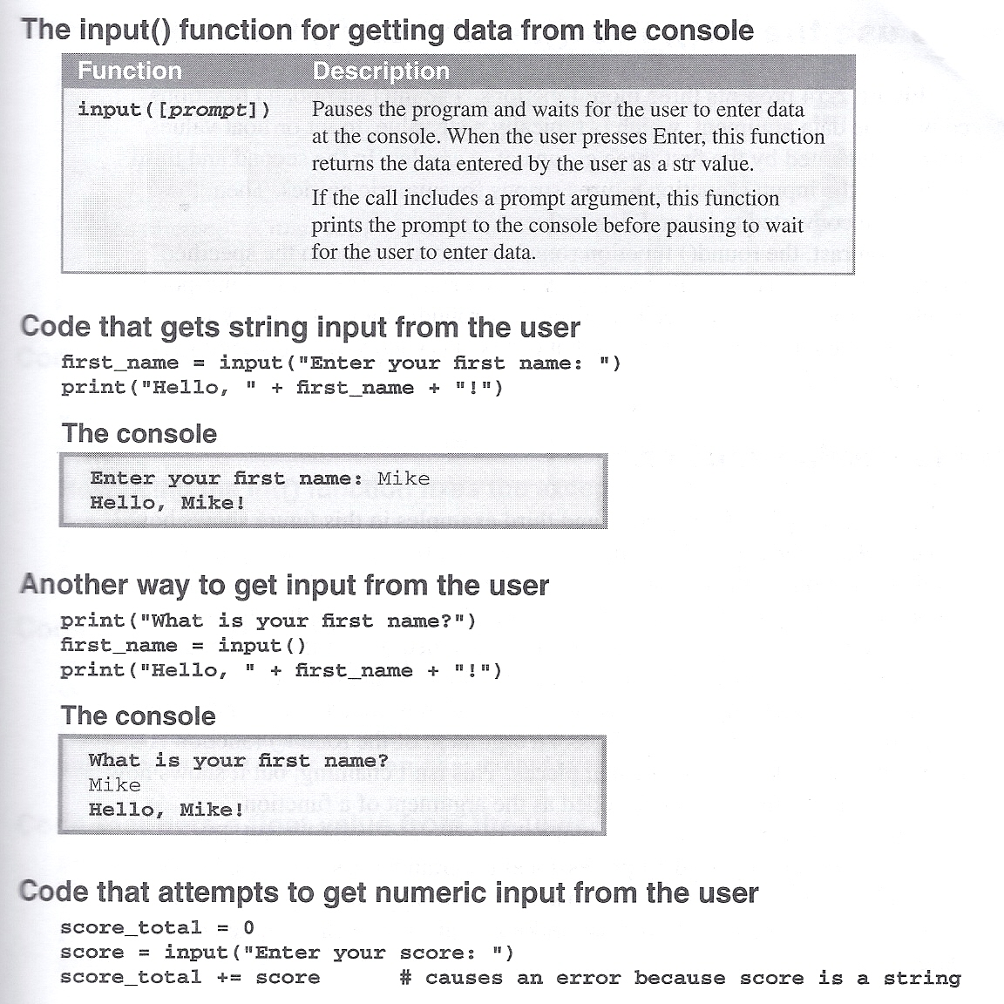
Reading Input with the input function
Most programs need to read input from the user
Built-in input function reads input from keyboard
Returns the data as a string
Format: variable = input(prompt)
prompt is typically a string instructing user to enter a value
Does not automatically display a space after the prompt

Slide 23
Reading Numbers with the input Function
input function always returns a string
Built-in functions convert between data types
int(item) converts item to an int
float(item) converts item to a float
Nested function call: general format: (also called “chaining”) function1(function2(argument))
value returned by function2 is passed to function1
Type conversion only works if item is valid numeric value, otherwise, throws exception

Slide 24
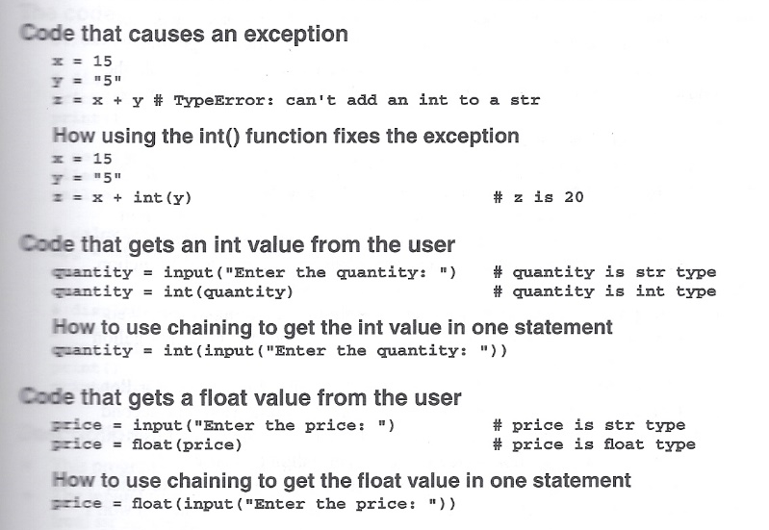

Slide 25
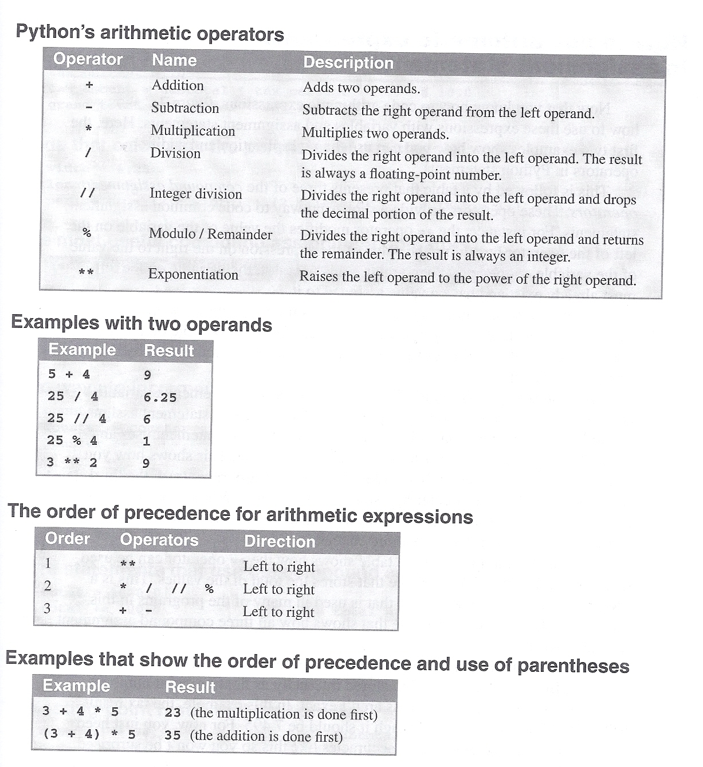
Performing Calculations
Math expression: performs calculation and gives a value (usually to a variable)
Math Operator: tool for performing calculation
Operands: values or variables surrounding operator

Slide 26
Performing Calculations
Python operator precedence:
Operations enclosed in parentheses
Exponentiation (**)
Multiplication (*), division (/ and //), and remainder (%)
Addition (+) and subtraction (-)
Higher precedence performed first
Same precedence operators execute from left to right

Slide 27
Performing Calculations
Data type resulting from math operation depends on data types of operands
Two int values: result is an int
Two float values: result is a float
int and float: int temporarily converted to float, result of the operation is a float
Mixed-type expression
Type conversion of float to int causes truncation of fractional part

Slide 28
